Slide 1
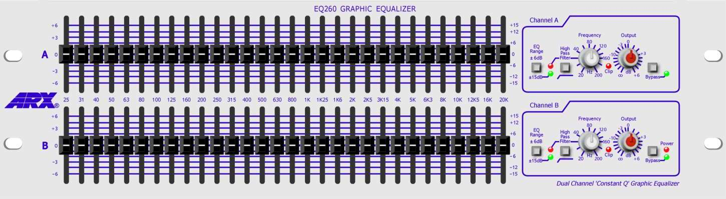
Graphic equalizer design with the Web Audio API

Slide 2

Equalisation
Filters change magnitudes & phases of a signal’s frequency content
Can use audio nodes in the Web Audio API to create filters
BiquadFilterNode – standard second order filters
IIRFilterNode – arbitrary fixed design filters
ConvolverNode – create a Finite Impulse Response (FIR) filter
Audio Worklet – create your own filters
Equalisation (EQ) is a form of filtering
Boosting or cutting certain frequency components in a signal
Origin
Trying to obtain flat frequency response
No colouration
A simple tool is the tone control

Slide 3
Tone controls
Most common equalisation is the tone control
Controls: bass and treble
Adjust sound to suit your taste
Bass control = low shelving filter
Treble control = high shelving filter
Control centred = unity gain = flat response
Boost
Boost
Cut
Cut

Slide 4
Tone controls - Midrange
In addition to bass and treble, midrange control
Peaking filter affects frequencies between highs and lows
Boost or cut portion of spectrum without affecting the rest
Does not attempt to isolate particular frequencies
Boost
Cut

Slide 5
Three tone controls, including peaking filter to adjust the midrange
Bass
Treble
Input audio
Output audio
Low shelf
High shelf
Bass and treble tone controls implemented as low and high shelf filters in series
Bass
Mids
Treble
Input audio
Low shelf
Peaking/ notch
High shelf
Output audio

Slide 6
Graphic equaliser
Lets user set gains for fixed frequency bands
Gain of each band generally controlled with slider
More flexible than tone control
More frequency bands available
6 to 40 bands is typical range
Like tone controls, centre frequencies are fixed
Boost or cut controlled with sliders
slider positions represent samples of magnitude response at different frequencies
Gives ‘graphic’ representation of frequency response
Band distribution is logarithmic in frequency
Matches human perception

Slide 7
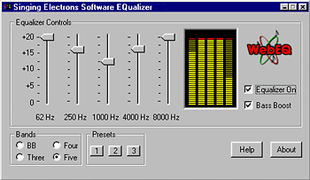
Graphic Equalisers and sliders
Manipulate each frequency band independently by inserting gain control
sliders on front of equaliser are gain controls in each band

Slide 8
Graphic EQ and octaves
Centre frequencies usually equally spaced in octaves
Logarithmic, not linear, in frequency
Octave is factor of 2
1/3 octave spacing based on factor of 2^{1/3} ~ 1.26
Examples
1 octave spacing starting at 100Hz would have...
200Hz, 400Hz, 800Hz, 1.6kHz, ...
1/3 octave spacing starting at 100Hz would have...
126Hz, 159Hz, 200Hz, 252Hz, 318Hz, 400Hz, ...
Q kept roughly constant for each frequency band
Gains are given in decibels

Slide 9
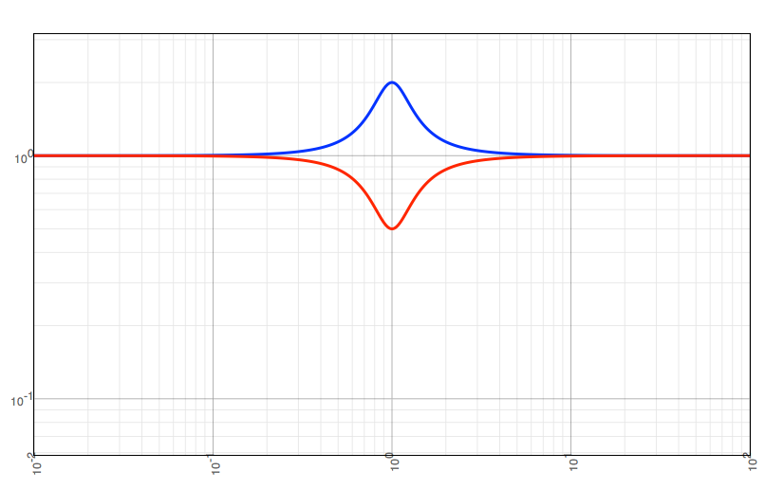
Series implementation
Consider cascade of peaking or shelving filters
Add boost or notch to a specific frequency band
First and last bands can be shelving filters
Each filter has gain of 1 outside the band
Arrange filters in series
Each takes its input from the previous filter
Boost/Cut
Level
Boost/Cut
Level
Boost/Cut
Level
Boost/Cut
Level
Boost/Cut
Level
Low shelf
Peaking
Peaking
...
Peaking
High shelf
Input
Output
50Hz
100Hz
200Hz
6.4kHz
12.8kHz
Gain of 1 (0dB)

Slide 10
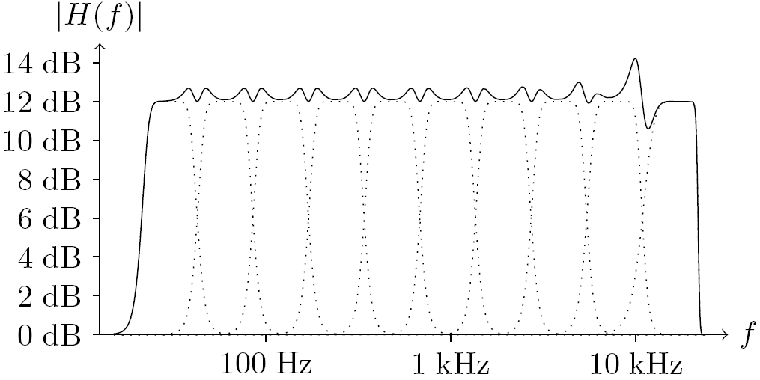
Octave equaliser
When same gain used in adjacent bands, want flat magnitude response
Real bandpass filters may have ripple in passband and don’t have a perfectly sharp cutoff
For 10-band octave equaliser
Magnitude response

Slide 11
Parallel implementation
Consider lowpass, bandpass and highpass filters
Completely isolate individual frequency bands
Input
Q=ω_{c}/B
...
|H|²
B
1
Lowpass
Bandpass
...
Highpass
Filters:
Bandpass
Gains:
Output
+
0
ω_{c}
π
Arrange filters in parallel
Each has same input
Outputs summed (mixed) after band gains adjusted

